Slide 1
Advanced Image Analysis
a.a. 2017-2018, 2nd semester
Module 3
Grayscale Morphology
Alessandro Bria
Contract Professor
and Post-doc Researcher
email: a.bria@unicas.it

Slide 2
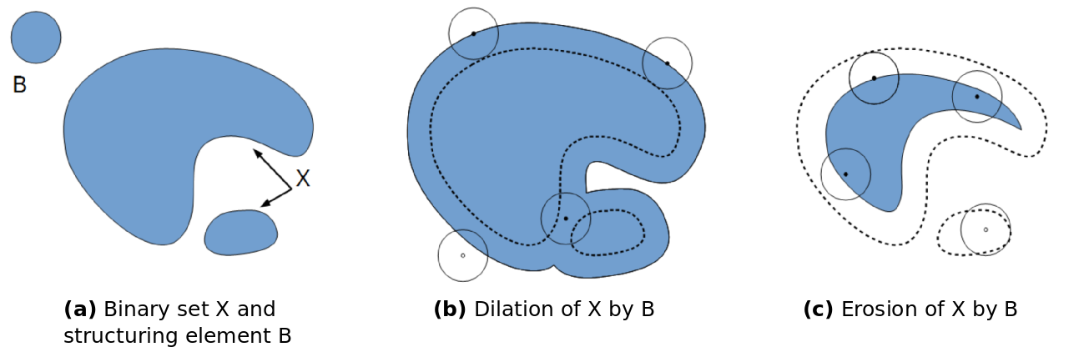
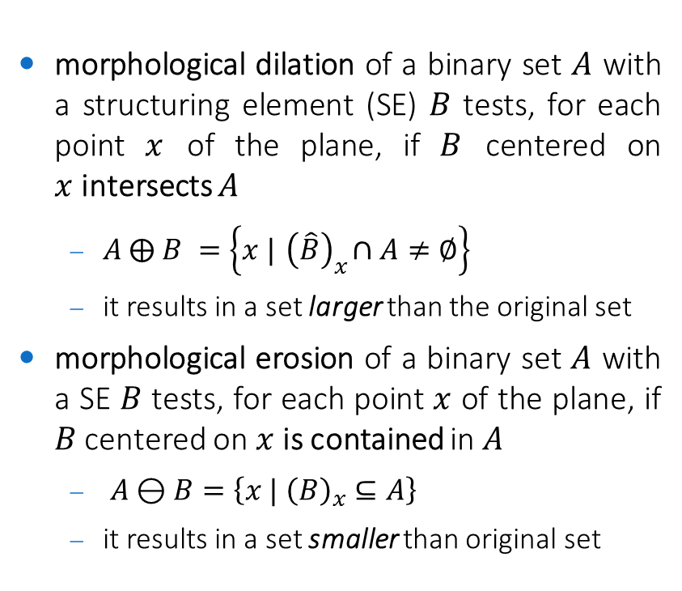
Binary Morphology
morphological dilation of a binary set $A$ with a structuring element (SE) $B$ tests, for each point $x$ of the plane, if $B$ centered on $x$intersects $A$
$A ⨁ B =\left\{x |{ \left(\hat{B}\right)}_{x}∩A≠∅\right\}$
it results in a set larger than the original set
morphological erosion of a binary set $A$ with a SE $B$ tests, for each point $x$ of the plane, if $B$ centered on $x$is contained in $A$
$A⊖B=\left\{x | {\left(B\right)}_{x}⊆A\right\}$
it results in a set smaller than original set

Slide 3
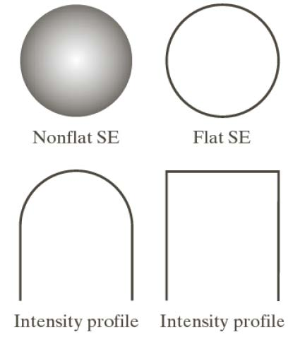
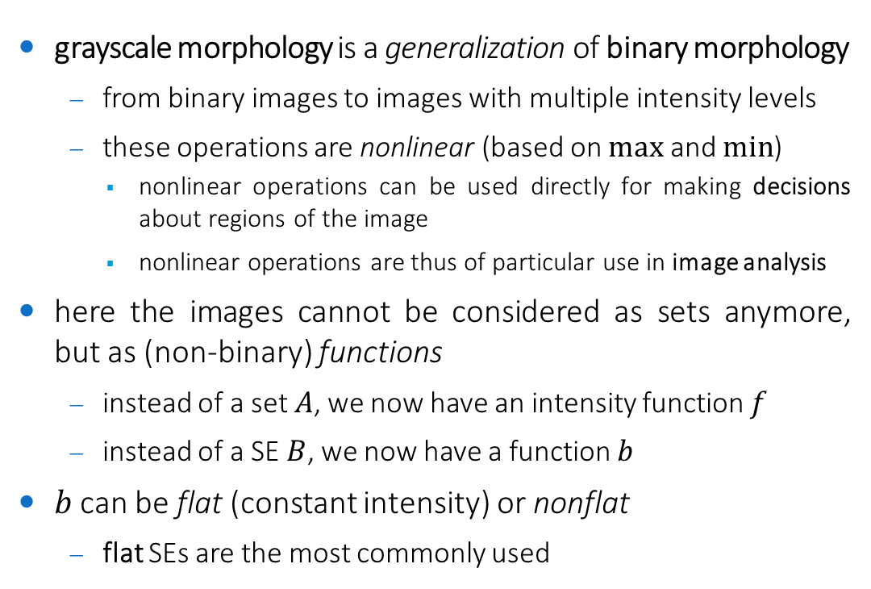
Grayscale Morphology
grayscale morphology is a generalization of binary morphology
from binary images to images with multiple intensity levels
these operations are nonlinear (based on $max$ and $min$)
nonlinear operations can be used directly for making decisions about regions of the image
nonlinear operations are thus of particular use in image analysis
here the images cannot be considered as sets anymore, but as (non-binary) functions
instead of a set $A$, we now have an intensity function $f$
instead of a SE $B$, we now have a function $b$
$b$ can be flat (constant intensity) or nonflat
flat SEs are the most commonly used

Slide 4
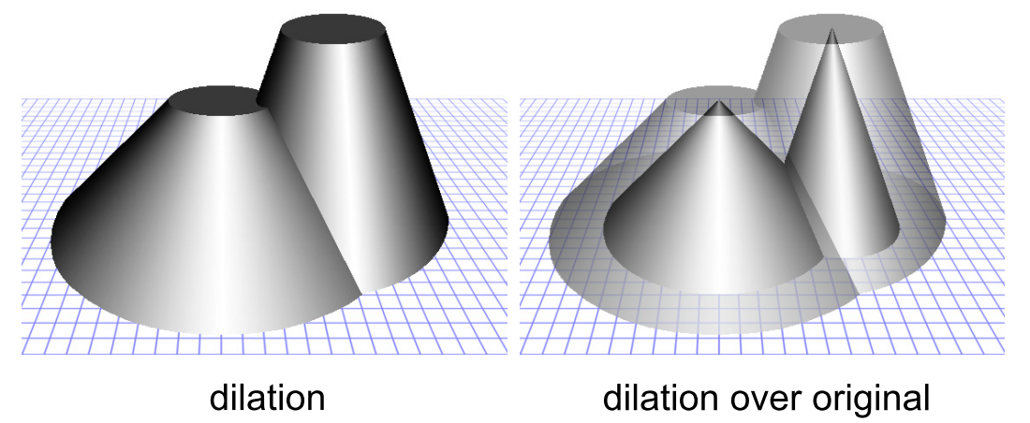
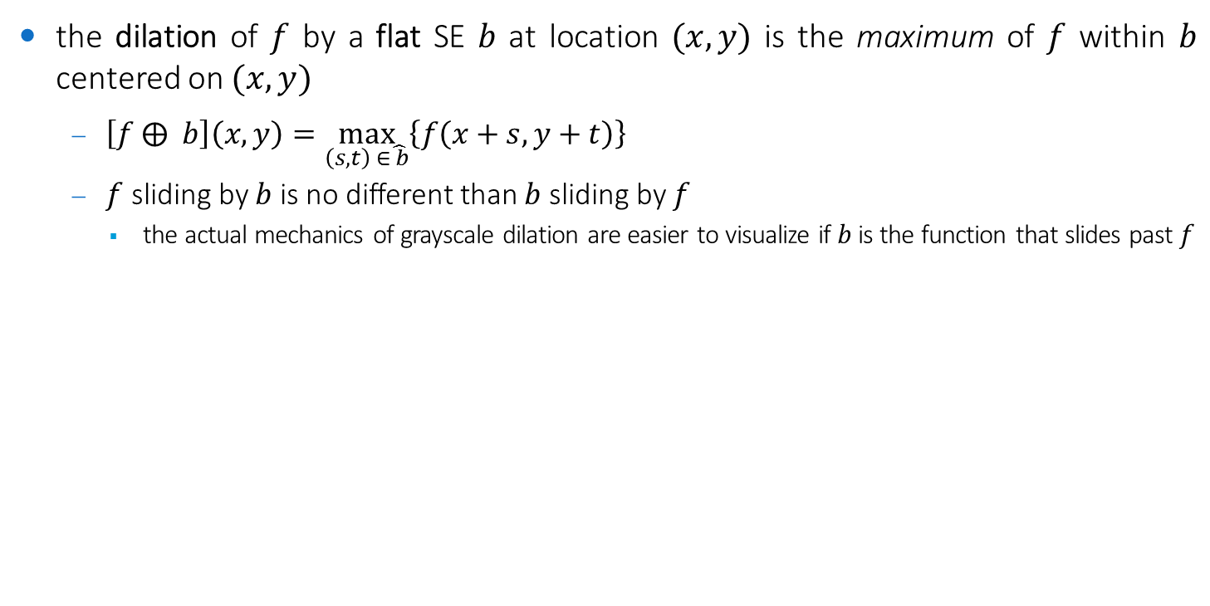
Flat dilation
the dilation of $f$ by a flat SE $b$ at location $(x,y)$ is the maximum of $f$ within $b$ centered on $(x,y)$
$\left[f ⨁ b\right]\left(x,y\right)=\max_{\left(s,t\right) ∈\hat{ b}}\left\{f\left(x+s,y+t\right)\right\}$
$f$ sliding by $b$ is no different than $b$ sliding by $f$
the actual mechanics of grayscale dilation are easier to visualize if $b$ is the function that slides past $f$

Slide 5
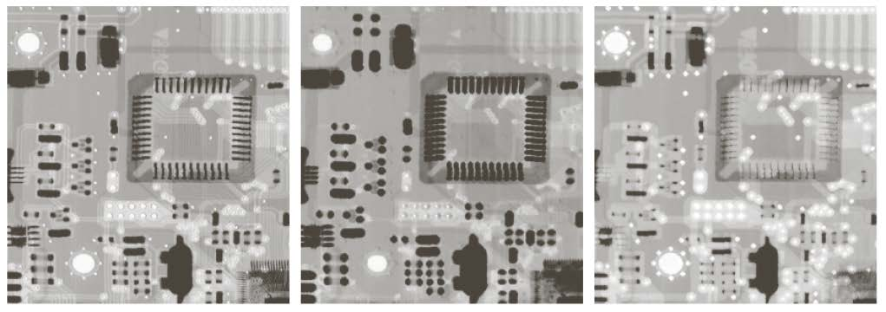
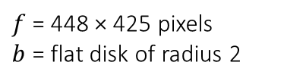
Flat dilation
the general effect of performing dilation on a grayscale image is twofold:
the output image tends to be brighter than the input
dark details either are reduced or eliminated, depending on how their values and shapes relate to the structuring element used for dilation
$f$ = 448 × 425 pixels
$b$ = flat disk of radius 2

Slide 6
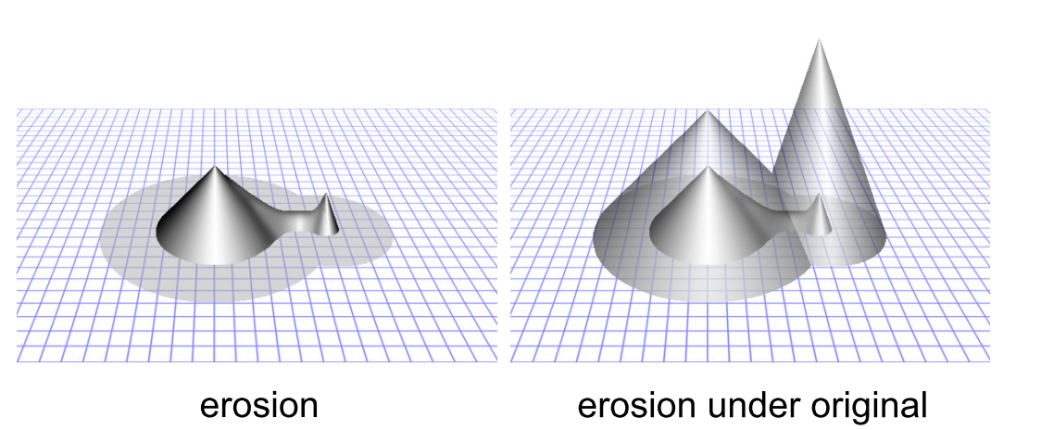
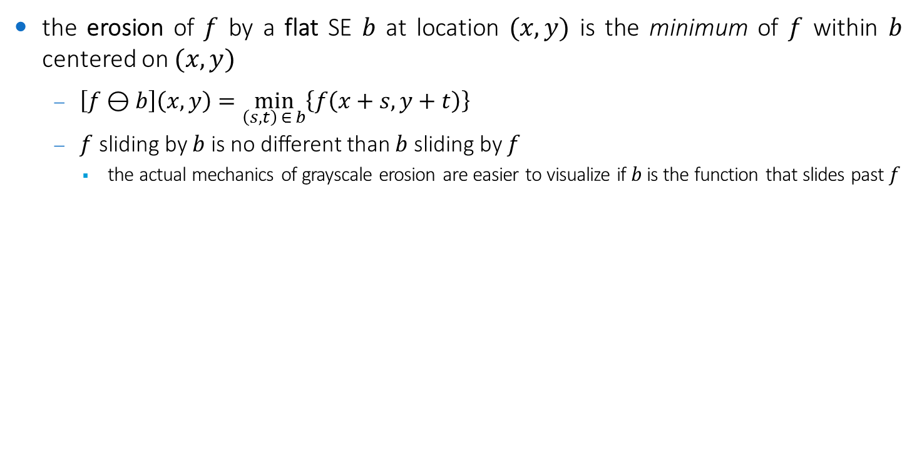
Flat erosion
the erosion of $f$ by a flat SE $b$ at location $(x,y)$ is the minimum of $f$ within $b$ centered on $(x,y)$
$\left[f⊖b\right]\left(x,y\right)=\min_{\left(s,t\right) ∈ b}\left\{f\left(x+s,y+t\right)\right\}$
$f$ sliding by $b$ is no different than $b$ sliding by $f$
the actual mechanics of grayscale erosion are easier to visualize if $b$ is the function that slides past $f$

Slide 7
Flat erosion
the general effect of performing erosion on a grayscale image is twofold:
the output image tends to be darker than the input
bright details either are reduced or eliminated, depending on how their values and shapes relate to the structuring element used for erosion
$f$ = 448 × 425 pixels
$b$ = flat disk of radius 2

Slide 8
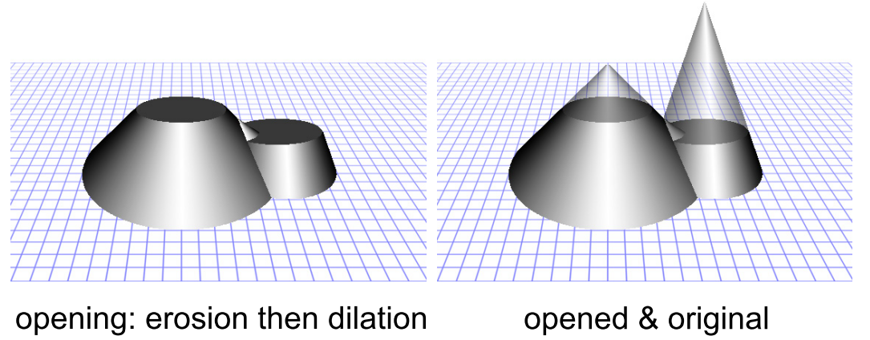
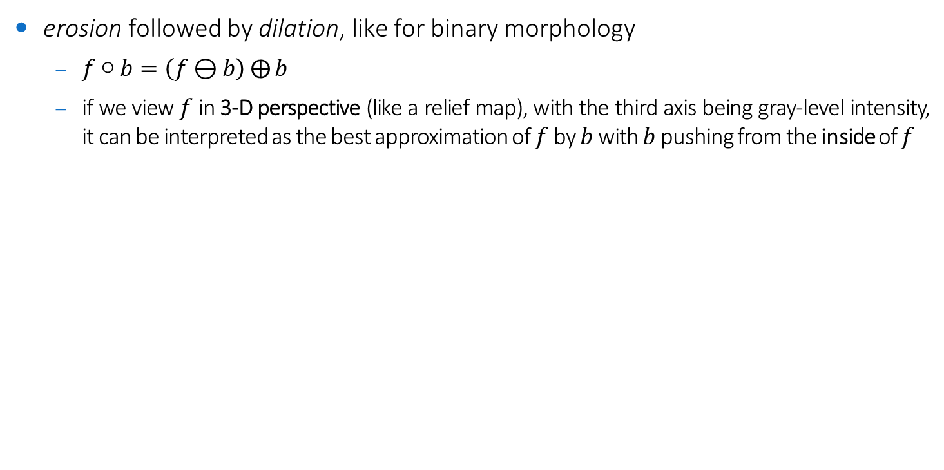
Opening
erosion followed by dilation, like for binary morphology
$f○b=\left(f⊖b\right)⨁{b}$
if we view $f$ in 3-D perspective (like a relief map), with the third axis being gray-level intensity, it can be interpreted as the best approximation of $f$ by $b$ with $b$ pushing from the inside of $f$

Slide 9
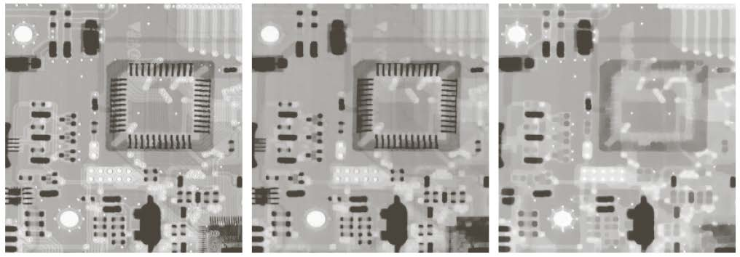
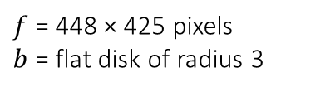
Opening
removes small (with respect to the size of the SE) bright details, while leaving the overall gray levels and larger bright features relatively undisturbed
the initial erosion removes small bright details, but it also darkens the image (removal)
the subsequent dilation increases the overall intensity of the image (restoring) without reintroducing the details totally removed by erosion
$f$ = 448 × 425 pixels
$b$ = flat disk of radius 3

Slide 10
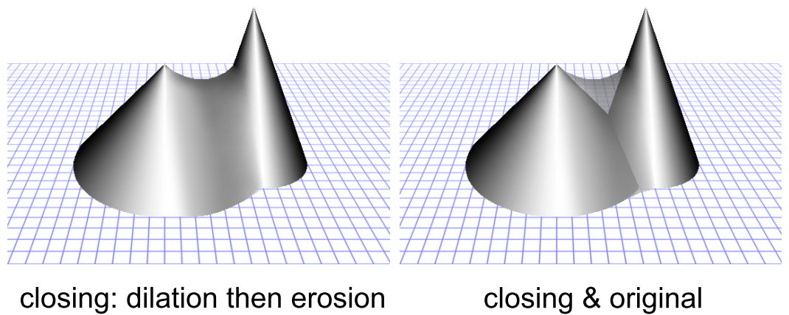

Closing
dilation followed by erosion, like for binary morphology
$f•b=\left(f⨁{b}\right)⊖b$
if we view $f$ in 3-D perspective (like a relief map), with the third axis being gray-level intensity, it can be interpreted as the best approximation of $f$ by $b$ with $b$ pushing from the outside of $f$

Slide 11
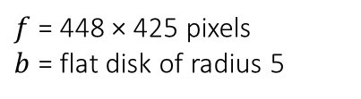
Closing
removes small (with respect to the size of the SE) dark details, while leaving the overall gray levels and larger dark features relatively undisturbed
the initial dilation removes small dark details, but it also brightens the image (removal)
the subsequent erosion decreases the overall intensity of the image (restoring) without reintroducing the details totally removed by dilation
$f$ = 448 × 425 pixels
$b$ = flat disk of radius 5

Slide 12
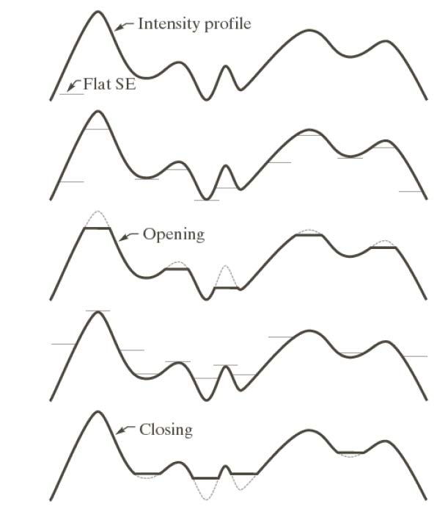
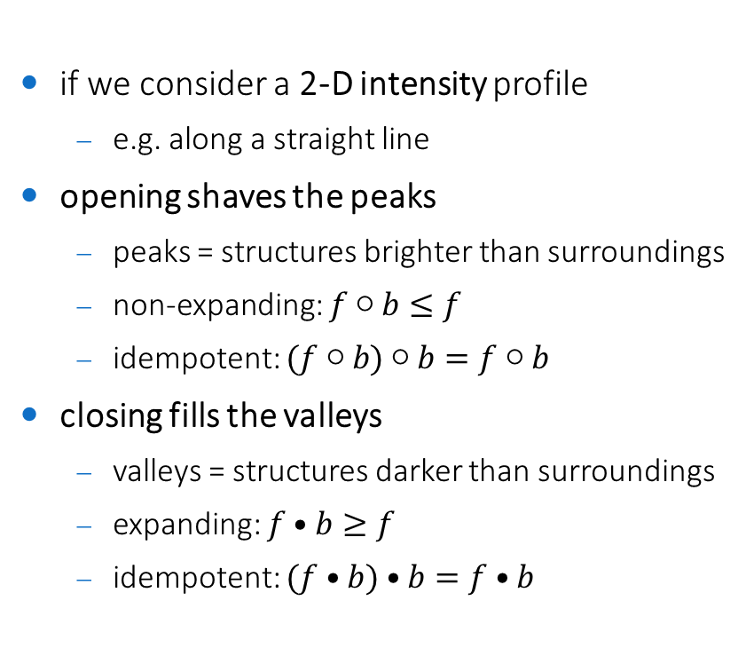
Opening and closing
if we consider a 2-D intensity profile
e.g. along a straight line
opening shaves the peaks
peaks = structures brighter than surroundings
non-expanding: $f○b≤f$
idempotent: $(f○b)$ $○b=f○b$
closing fills the valleys
valleys = structures darker than surroundings
expanding: $f•b≥f$
idempotent: $(f•b)•b=f•b$

Slide 13
Applications of Grayscale Morphology Morphological Smoothing Morphological Gradient Top-hat and Bottom-hat transforms Morphological Reconstruction

Slide 14
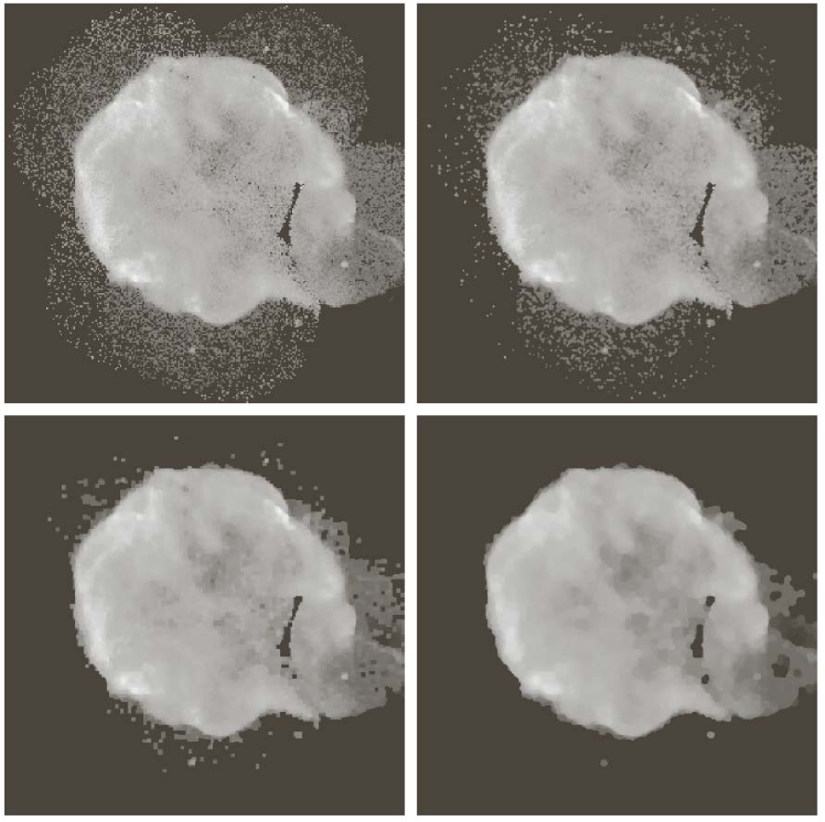
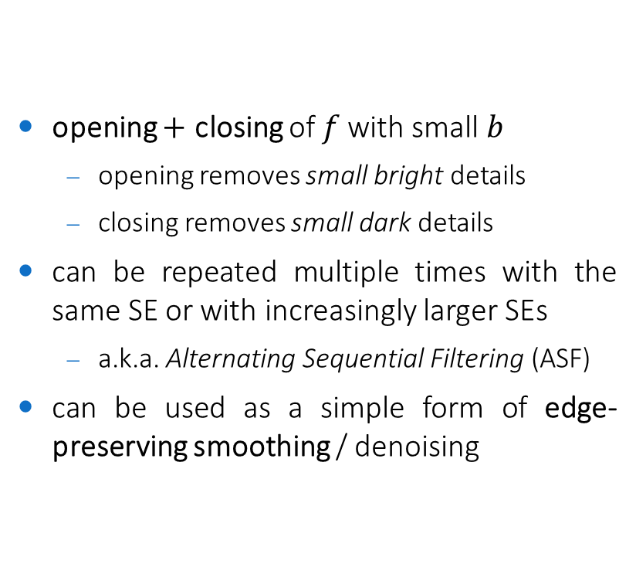
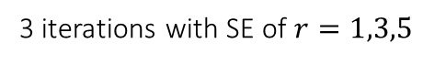
Morphological Smoothing (*)
opening $+$ closing of $f$with small $b$
opening removes small bright details
closing removes small dark details
can be repeated multiple times with the same SE or with increasingly larger SEs
a.k.a. Alternating Sequential Filtering (ASF)
can be used as a simple form of edge-preserving smoothing / denoising
3 iterations with SE of $r=1,3,5$
(*) example code available in labs/ocv-morphological_smoothing.cpp

Slide 15
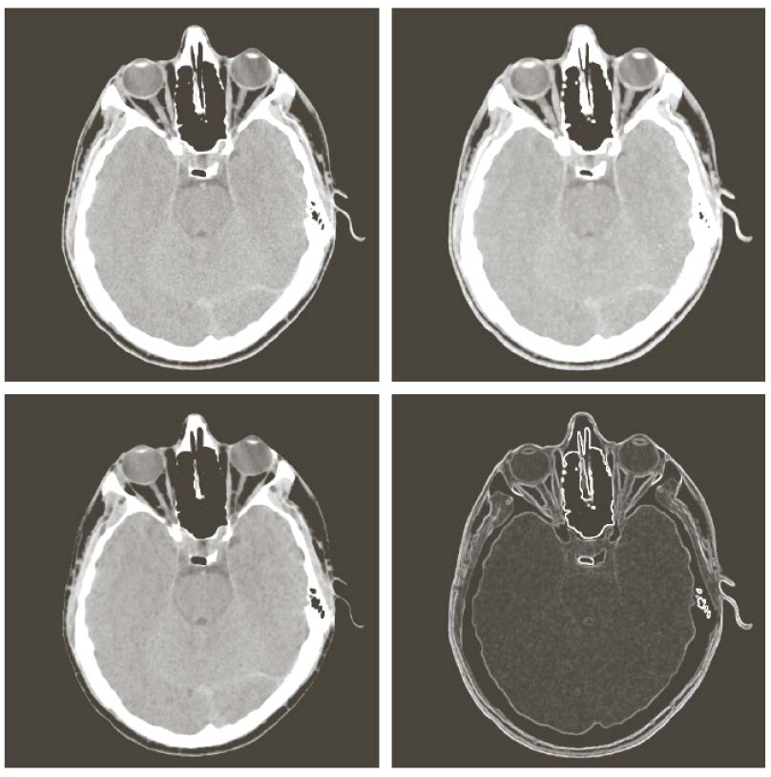

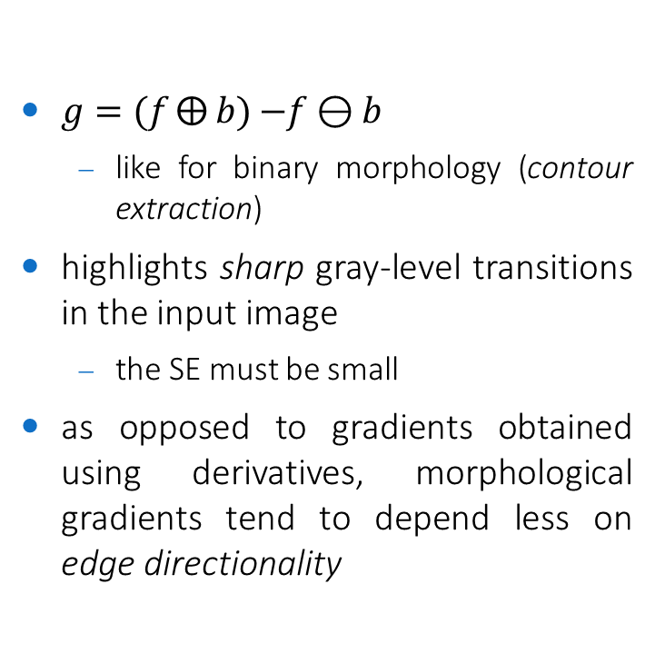



Morphological Gradient (*)
$g=(f⨁{b})$ $−f⊖b$
like for binary morphology (contour extraction)
highlights sharp gray-level transitions in the input image
the SE must be small
as opposed to gradients obtained using derivatives, morphological gradients tend to depend less on edge directionality
$$f$$
$$f⨁b$$
$$f⊖b$$
$$g$$
(*) example code available in labs/ocv-morphological_gradient.cpp

Slide 16
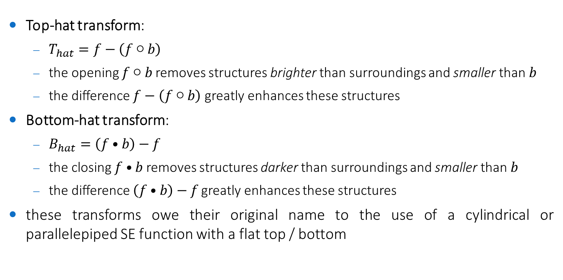
Top-hat and Bottom-hat transforms
Top-hat transform:
$T_{hat}=f−\left(f○b\right)$
the opening $f○b$removes structures brighter than surroundings and smaller than $b$
the difference $f−\left(f○b\right)$ greatly enhances these structures
Bottom-hat transform:
$B_{hat}=\left(f•b\right)−f$
the closing $f•b$ removes structures darker than surroundings and smaller than $b$
the difference $\left(f•b\right)−f$greatly enhances these structures
these transforms owe their original name to the use of a cylindrical or parallelepiped SE function with a flat top / bottom

Slide 17
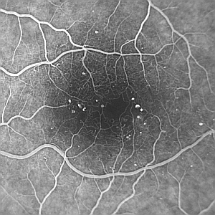
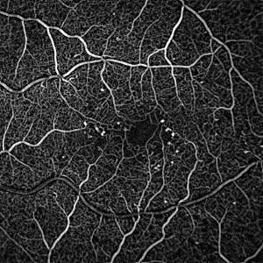
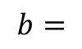
Top-hat to enhance structures of interest
automated detection of microaneurysms in eye angiograms
single top-hat transform with symmetric SE
$$b=$$

Slide 18
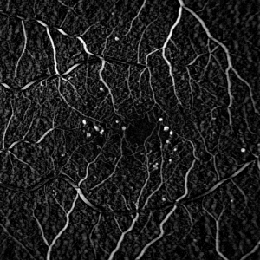
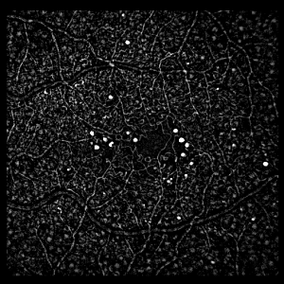
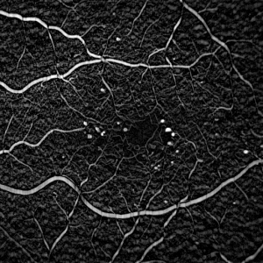
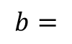
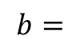
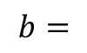
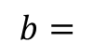
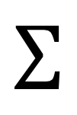
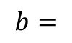
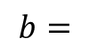
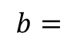

Top-hat to enhance structures of interest
automated detection of microaneurysms in eye angiograms
sum of top-hat transforms with a linear SE taken at different orientations
$$b=$$
$$b=$$
$$b=$$
$$…$$
$$Σ$$
$$b=$$
$$b=$$
$$b=$$
$$b=$$

Slide 19
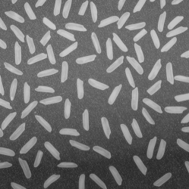

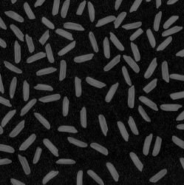
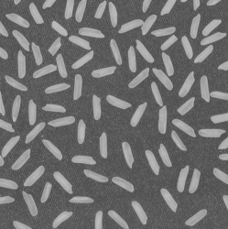
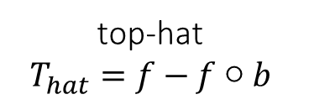
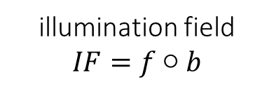


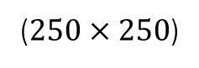
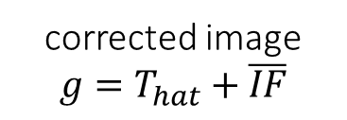
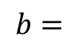
Top-hat to correct nonuniform illumination (*)
original image $f$
illumination field
$$IF=f○b$$
$$b=$$
$$40×40$$
($250×250$)
top-hat
$$T_{hat}=f−f○b$$
corrected image
$$g=T_{hat}+\overline{IF}$$
(*) example code available in labs/ocv-tophat-illumination-correction.cpp

Slide 20
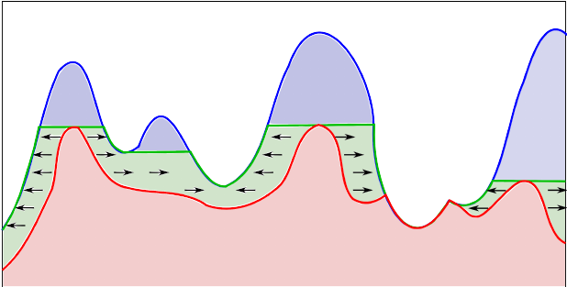

Morphological Reconstruction
the principle of morphological/geodesic reconstruction is to repeat dilations (or erosions) of an image, called marker, until the intensity profile of the marker fits under (or above) a second image, called mask
reconstruction by repeated dilations until idempotence
mask
repeated dilations
marker $⊆$ mask

Slide 21
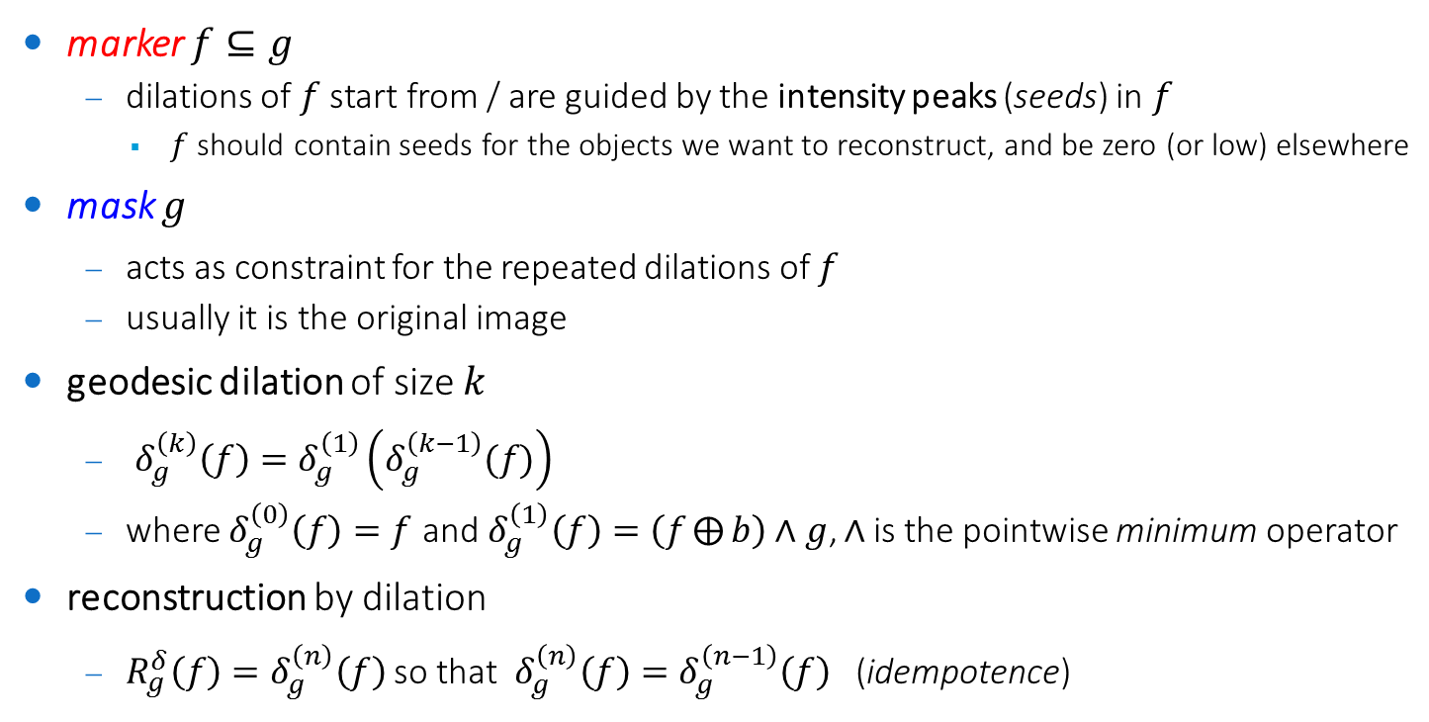
Morphological Reconstruction by Dilation
marker $f⊆g$
dilations of $f$ start from / are guided by the intensity peaks (seeds) in $f$
$f$should contain seeds for the objects we want to reconstruct, and be zero (or low) elsewhere
mask $g$
acts as constraint for the repeated dilations of $f$
usually it is the original image
geodesic dilation of size $k$
$δ_{g}^{\left(k\right)}\left(f\right)=δ_{g}^{\left(1\right)}\left(δ_{g}^{\left(k−1\right)}(f)\right)$
where $δ_{g}^{\left(0\right)}\left(f\right)=f$ and$δ_{g}^{\left(1\right)}\left(f\right)=\left(f⨁{b}\right)∧g$, $∧$is the pointwise minimum operator
reconstruction by dilation
$R_{g}^{δ}\left(f\right)=δ_{g}^{\left(n\right)}\left(f\right)$ so that $δ_{g}^{\left(n\right)}\left(f\right)=δ_{g}^{\left(n−1\right)}\left(f\right)$ (idempotence)

Slide 22
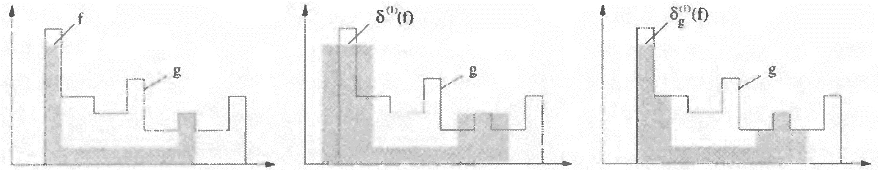
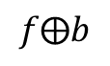


Morphological Reconstruction by Dilation
$$f⨁b$$
$$\left(f⨁b \right)∧g$$
$$b=$$

Slide 23

Morphological Reconstruction by Dilation

Slide 24







Morphological Reconstruction by Dilation: examples
the success of Morphological Reconstruction stays in the choice of the marker $f$
e.g. automated detection of microaneurysms in eye angiograms
$f=$ max of openings of $g$ with linear SEs at different orientations
mask $g$
marker $f$
$$R_{g}^{δ}\left(f\right)$$
$${g−R}_{g}^{δ}\left(f\right)$$

Slide 25













Morphological Reconstruction by Dilation: examples (*)
e.g. star/galaxy discrimination in astronomical images
mask image $g$
marker image $f$
($1600×1200$)
$$f=g○b$$
$$b=$$
$$30×30$$
(bigger than stars)
reconstruction
$$R_{g}^{δ}\left(f\right)$$
difference image
$$g−R_{g}^{δ}\left(f\right)$$
$$b=$$
(not so important)
(*) example code available in labs/ocv-gray-morph-reconstruction.cpp

